Slide 1


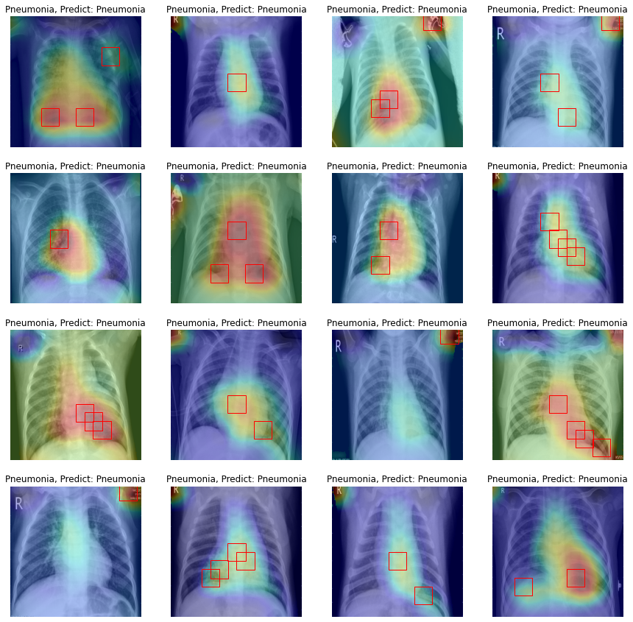
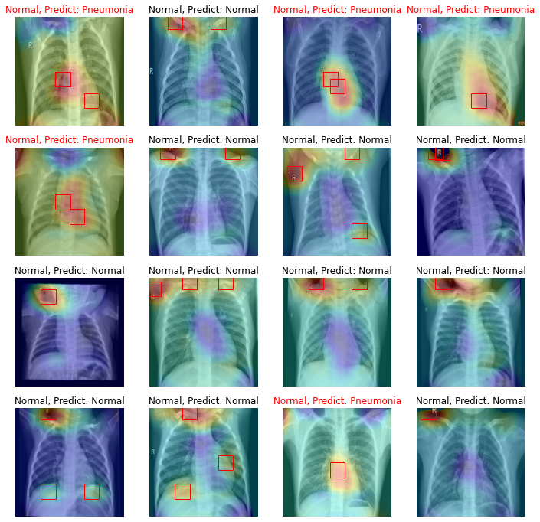

Slide 2
Abnormality localization in lung with Pneumonia using Vgg16
Shu-wei Huang

Slide 3
Data
Data from https://www.kaggle.com/code/ernestomaisuls/pneumonia-detection-in-x-ray
It contains normal and opacity X-ray lung images, and opacity images include bacterium and virus Pneumonia

Slide 4
CNN Model
Convolution Neural Network (CNN) which is used in this case is pretrained Vgg16.
The model has 5 blocks of CNN layers, and I sat 1-4 blocks are untrainable. These blocks are a feature extractor.
After CNN block 5, feature kernels is processed by Global-Average-Pooling-2D rather than Flatten.
After that, features connect to two output neurons.
Train this model as a classifier.

Slide 5
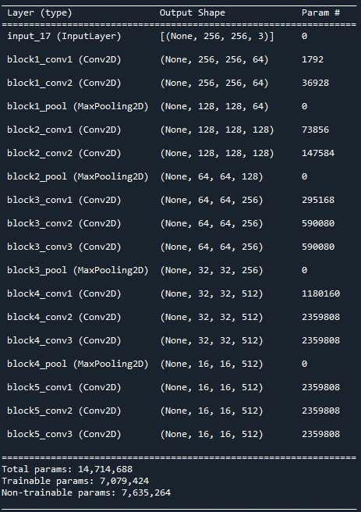
CNN Model
Code refers to https://www.youtube.com/watch?v=P9NdQG_vIvo
Block 1
Block 2
Block 3
Block 4
Block 5
GAP 2D
2 output
After training, 2 output layer will be removed.
Block 1
Block 2
Block 3
Block 4
Block 5
GAP 2D

Slide 6
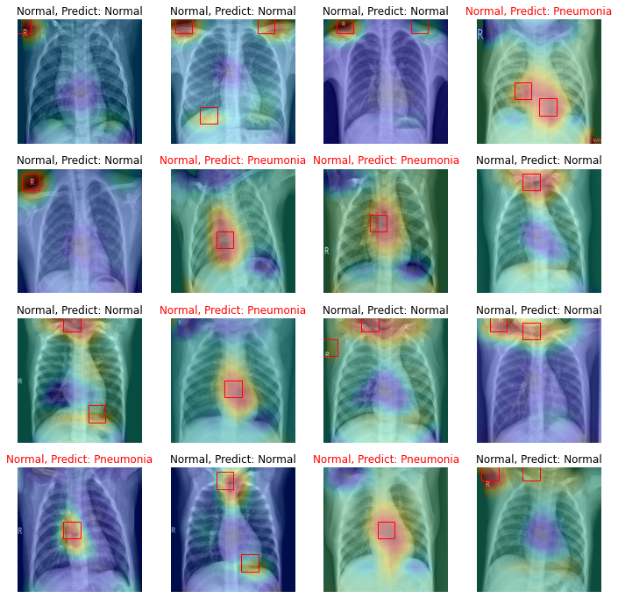
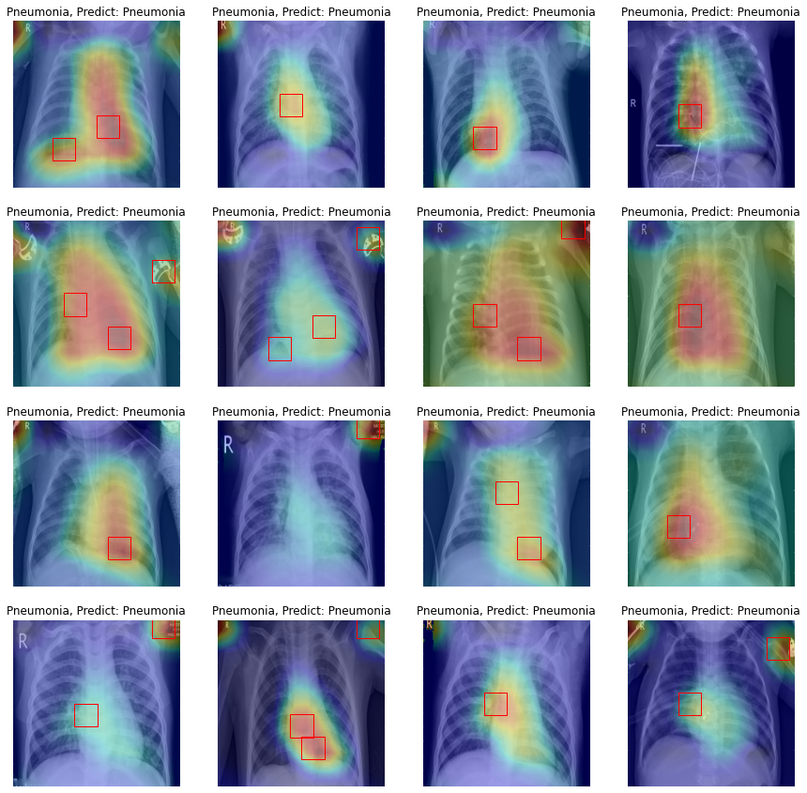
Result
Normal lungs
Lungs with Pneumonia

